Slide 1
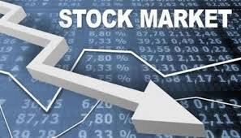
Stock Market
Jamel Ben Chafra

Slide 2
What is Stock Market?
Place where shares of public listed companies are traded.
Aggregation of buyers and sellers of stocks.
Represent ownership claims of businesses.
Notes:
Don’t forget to mention that the business volume of stock markets worldwide rose to around 95 trillion USD by the end of 2020.

Slide 3
Turkish Stock Market Yearly Closing Index Statistics
Year | Closing Index
2014 | 801.910
2015 | 717.270
2016 | 781.387
2017 | 1,153.330
2018 | 888.308
2019 | 1,136.840
2020 | 1,476.720
2021 | 1,857.650
2022 | 5,509.160

Slide 4
Stock Market Crashes
Black Thursday (1929)
Black Monday (1987)
Great Recession (2007 – 2009)
COVID-19 Outbreak (2020)

Slide 5
Factors affecting Stock Prices
Supply / Demand Imbalances
Interest Rate Fluctuations
Company-specific Factors

Slide 6
Factors affecting Stock Prices
Investor Sentiment
Supply / Demand Imbalances
Interest Rate Fluctuations
Company-specific Factors

Slide 7
Invest, invest and invest!

